Slide 1
CHAPTER 4
TEST REPORT
Software Testing
SESSION 2

Slide 2
Contents
1
Test Report
2
Defect Management
4

Slide 3
1. Test Report
It is a document which contains a summary of all test activities and final test results of a testing project.
Test report is an assessment of how well the Testing is performed.
Based on the test report, stakeholders can evaluate the quality of the tested product and make a decision on the software release

Slide 4
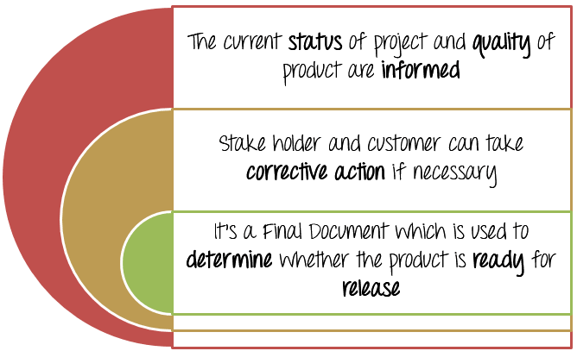
1. Test Report
Benefits of test report

Slide 5
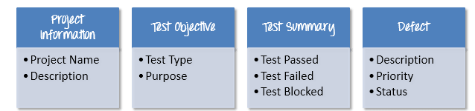
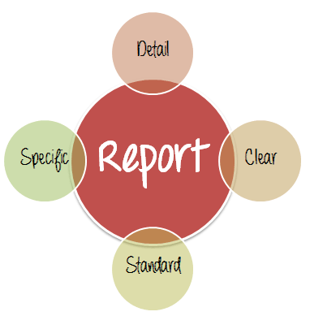
1. Test Report
Test report contains:
A good test report should be:
  Detail
  Clear
  Standard
  Specific

Slide 6
2. Defect Management
Defect Life cycle
Defect handling process
Priority and Severity of bug
Bug report

Slide 7
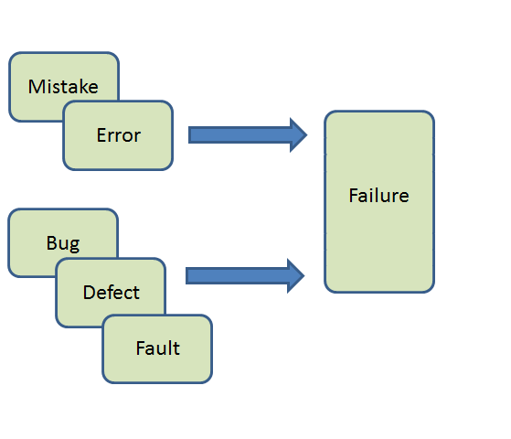
What is a bug?
A bug is known as defect or fault which is a manifestation of an error in software.
Deviation from expected result

Slide 8
What is a bug?
Bug types:
  Bugs in requirements
    When requirement is incorrect, unambiguous, inconsistent or incomplete
    When requirement contradict to business flow in case when it exists
  Functional bugs in application
    Nonconformance to requirements
    Something that does not correspond to valid Customer’s expectations/common sense that are assumed but may be not described in product requirements.

Slide 9
2.1. Defect Life cycle
Defect life cycle is a cycle which a defect goes through during its lifetime.
It starts when defect is found and ends when a defect is closed, after ensuring it’s not reproduced.
Defect life cycle is related to the bug found during testing.
The bug has different states in the Life Cycle: New, rejected, deferred, duplicate, in progress,fixed, re-open, closed

Slide 10
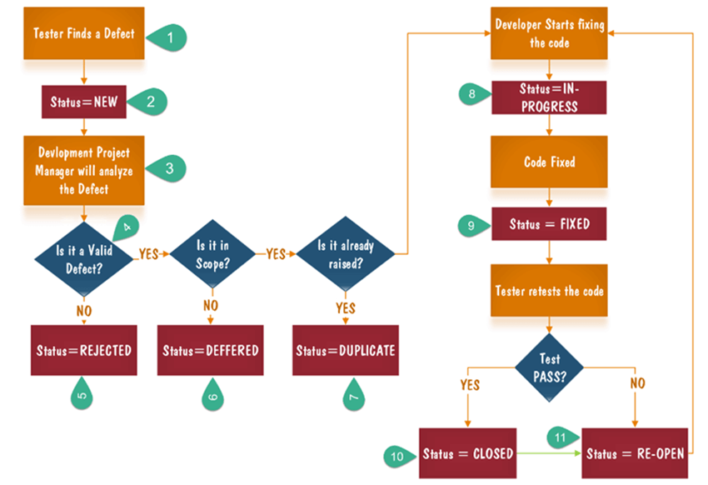
2.1. Defect Life Cycle

Slide 11
2.1. Defect Life Cycle
Tester finds the defect
New: When a defect is logged and posted for the first time. It’s state is given as new.
Defect is forwarded to Project Manager for analyze
Project Manager decides whether defect is valid
Here the defect is not valid- status given "Rejected."
If the defect is not rejected then the next step is to check whether it is in scope.
Next, manager verifies whether a similar defect was raised earlier. If yes defect is assigned a status duplicate.
Notes:
The bug, changed to deferred state means the bug is expected to be fixed in next releases. The reasons for changing the bug to this state have many factors. Some of them are priority of the bug may be low, lack of time for the release or the bug may not have major effect on the software.
Suppose we have another function- email functionality for the same application, and you find a problem with that. But it is not a part of the current release then such defects are assigned as a postponed or deferred status.

Slide 12
2.1. Defect Life Cycle
If no the defect is assigned to the developer who starts fixing the code. During this stage, the defect is assigned a status in- progress.
Once the code is fixed. Defect is assigned a status fixed
Next the tester will re-test the code. In case, the Test Case passes the defect is closed.
If the test cases fails again, the defect is re-opened and assigned to the developer.

Slide 13
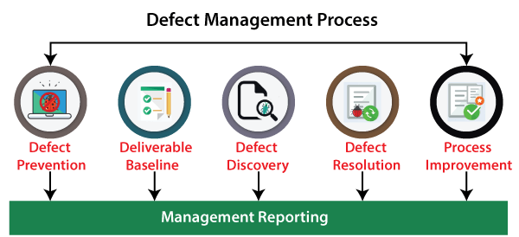
2.2 Defect Handling Process
The defect management process includes several stages, which are as follows:
Notes:
https://www.javatpoint.com/defect-management-process

Slide 14
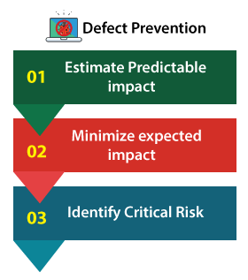
2.2 Defect Handling Process
Defect Prevention:
In this stage, the execution of procedures, methodology, and standard approaches decreases the risk of defects.
Notes:
https://www.javatpoint.com/defect-management-process

Slide 15
2.2 Defect Handling Process
2. Deliverable Baseline
The deliverable is a baseline as soon as a deliverable reaches its pre-defined milestone.
In this stage, the deliverable is carried from one step to another; the system's existing defects also move forward to the next step or a milestone.
The pre-defined milestone describes what software is supposed to accomplish.
Notes:
The second stage of the defect management process is the Deliverable baseline. Here, the deliverable defines the system, documents, or product.
We can say that the deliverable is a baseline as soon as a deliverable reaches its pre-defined milestone.

Slide 16
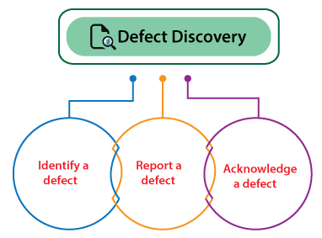
2.2 Defect Handling Process
3. Defect Discovery
If developers have approved or documented the defect as a valid one, then only a defect is considered as discovered.

Slide 17
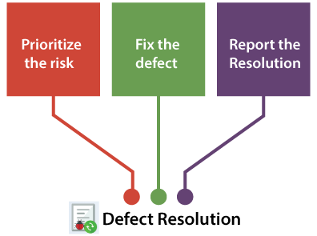
2.2 Defect Handling Process
4. Defect Resolution
This process is used to specified and track the defects.

Slide 18
2.2 Defect Handling Process
5. Process Improvement
In this phase, we will look into the lower priority defects because these defects are also essential as well as impact the system.
6. Management Reporting
The management reporting is required to make sure that the generated reports have an objective and increase the defect management process.

Slide 19
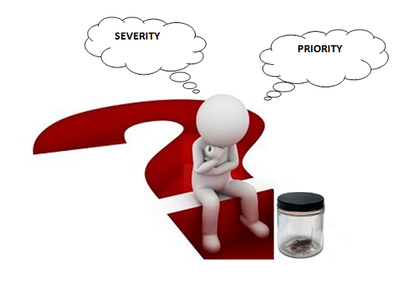
2.3. Priority and Severity

Slide 20
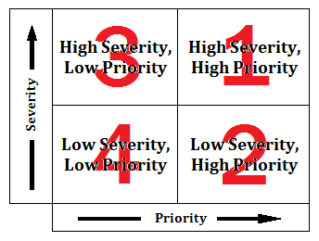
Priority is defined as the order in which a defect should be fixed in accordance to business value or other project/ customer needs
Severity defines the impact that a given defect has on the system, so how bad the defect is.
Impact on functionality
How serious is the bug?
Scheduling
How soon to fix the bug?

Slide 21
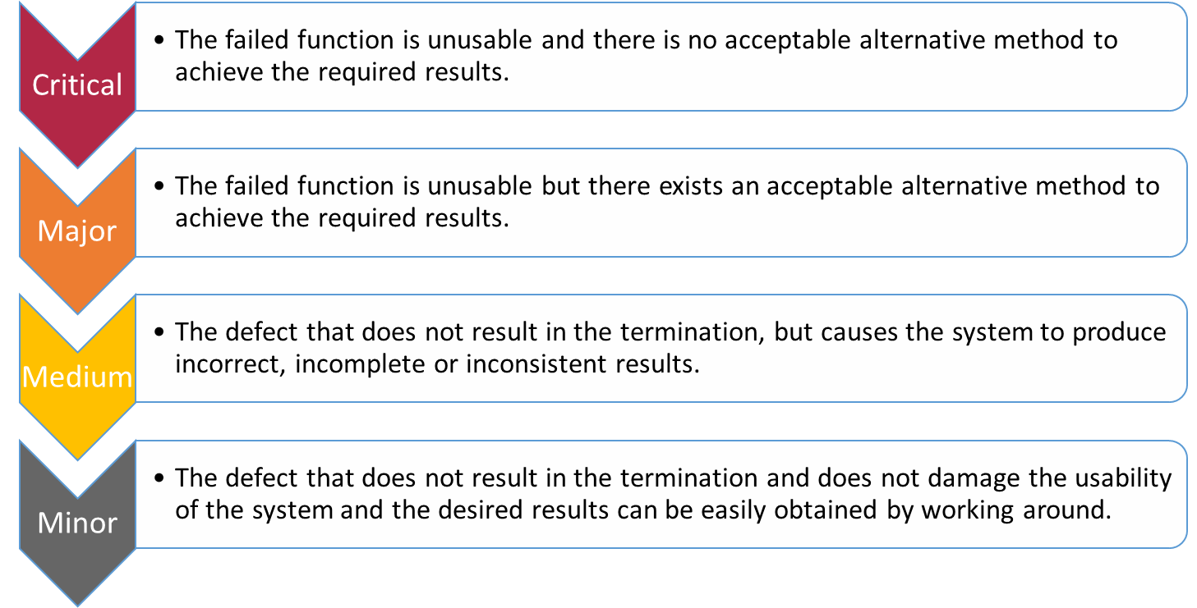
Severity levels

Slide 22
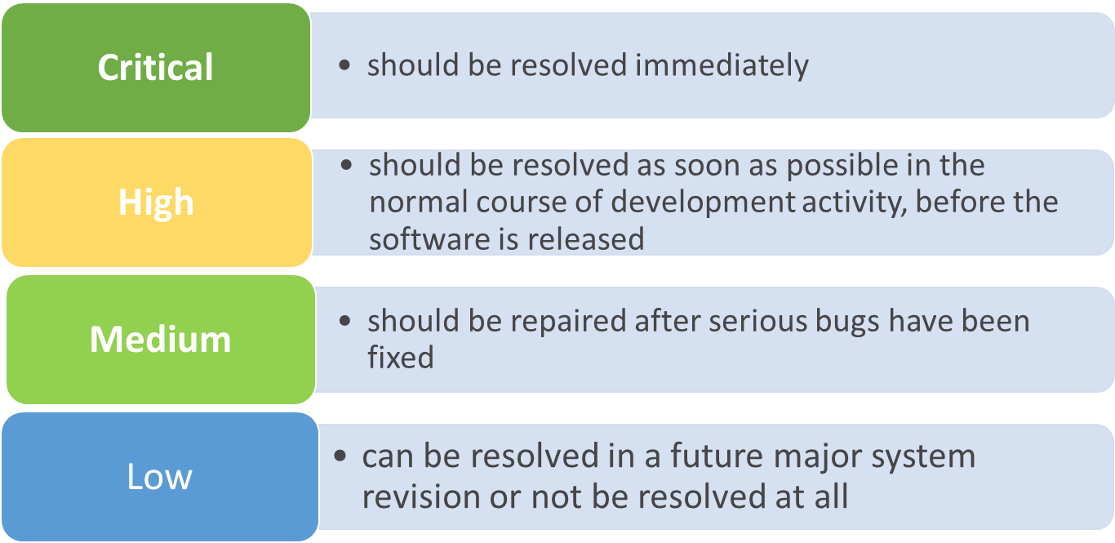
Priority levels

Slide 23
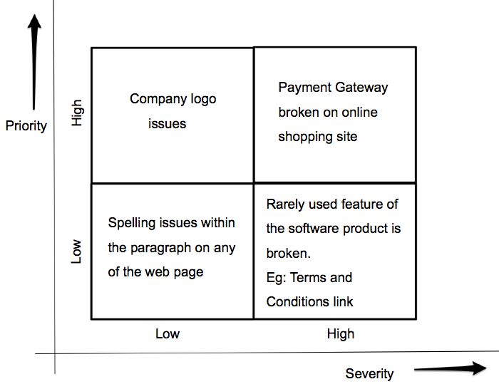
Severity & Priority examples

Slide 24

2.4. Bug Report
Defect report is a technical document written to describe the symptoms of a bug to:
  communicate the impact of a quality problem
  prioritize the bug for fixing
  help the programmer locate the underlying defect and fix it

Slide 25

2.4 Bug Report
Why do we need to report bugs?
1
2
Measure product quality
3
Define risky areas/configurations/testing types/etc.

Slide 26
2.4 Bug Report
Bug report provides information to
Tester
How to reproduce?
Why is it a bug?
Expected result
Developer
How to reproduce?
Why is it a bug?
What is expected result and why?
Customer
How bad is the bug?
Affected area

Slide 27
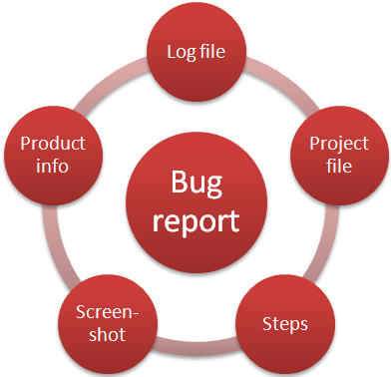
2.4 Bug Report
Bug report can contains sets of mandatory and optional fields
What fields are mandatory and what are optional and filling rules are defined on each project
Most bug tracking system allow to configure these fields and rules

Slide 28
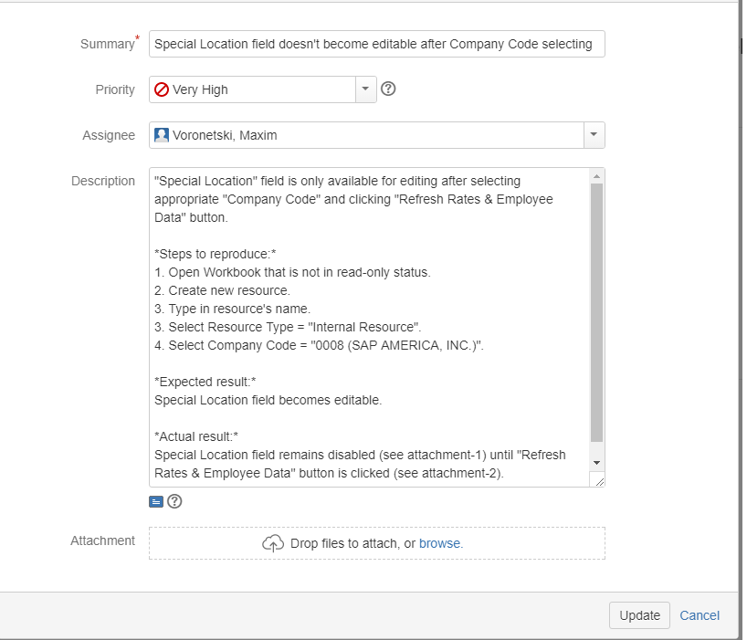
2.4 Bug report: mandatory fields
Mandatory bug report fields:
  Summary
  Severity
  Priority
  Description
  Steps to Reproduce
  Actual and Expected Results
  Attachment

Slide 29
2.4 Bug report: Summary
Summary gives enough information to understand what the problem is and how you can reproduce it.
Good summary is built based on the following schema:
What – Where – When
Example: Bad summary:
It’s impossible to save Concept
Example: Good summary:
It’s impossible to save Concept with long description created via HTML Editor

Slide 30
2.4 Bug report: Description
Description gives detailed and clear interpretation of a problem, explains why it is a bug, includes the following information:
  Description of application behavior (e.g. interpretation of test failures)
  Justifications of why this is a bug
  Any relevant links
  Interpretation of the specification
  Examples from other areas
Not copy of summary!

Slide 31
2.4 Bug report: Steps to reproduce
General recommendations:
  Show the scenario how to recreate the bug on any system
  Check that steps provide clear instructions, so that others can consistently reproduce it
  Use the rule: new action = new step
  Include test data on which is reproduced
  Test your own instructions

Slide 32

2.4 Bug report: Actual & Expected results
The test results, including Expected Result and Actual Result, will show what's wrong.
Actual Result describes what actually happened, what currently happens when the bug is present.
Expected Result describes what should happen if the bug was fixed.

Slide 33
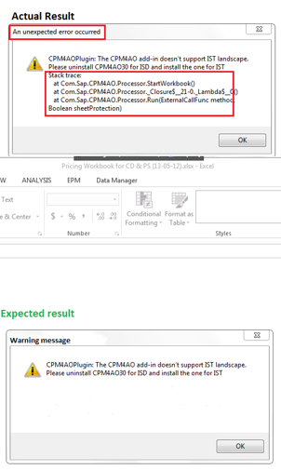
2.4 Bug report: Attachment
Attachment can be like:
Pictures (screenshots)
Files (any kind of logs)
DB query (to get test data);
Documents
Video (just in case of hard reproducible bug)

Slide 34
2.4 Bug Report: Optional bug report fields
List of the most common and useful optional fields:
Issue Type:
    Regression issues/New Feature/Configuration/Integration/etc.
Component:
    Functional components/areas in application, e.g. payments, user login
Environments:
    QA, DEV, UAT, PROD
Found Version
Fix Version
Labels
…

Slide 35
2.4 Bug report: A good defect example
Summary
  Severity
  Priority
  Steps to reproduce
Expected Results
Actual Results
Special Location field doesn’t become editable after selecting Company Code
  Major
  High
  “Special Location” field is only available for editing after selecting appropriate “Company Code” and clicking “Refresh Rates & Employee Data” button
  1. Open Workbook that is not in read-only status
  2. Create new resource
  3. Type in resource’s name
  4. Select one of Resource Type, for example “Internal Resource”
  5. Select appropriate Company Code, “0008” for our example
Special Location field becomes editable
Special Location field remains disable (see attachment-1) until “Refresh Rates & Employee Data” button is clicked (see attachment-2)

Slide 36
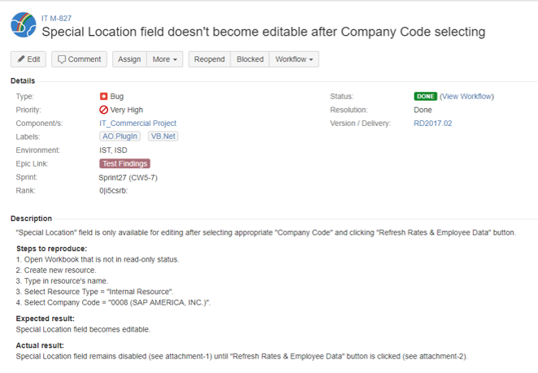
2.4 Bug report: A good defect example

Slide 37
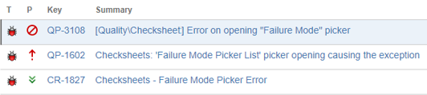
What is a bad bug report?
Bad bug report is a bug report that duplicates already existing bugs
Bad bug report is a bug report that contains just opinions or complaints
Examples:
It doesn’t work!
My computer crashed!
…

Slide 38
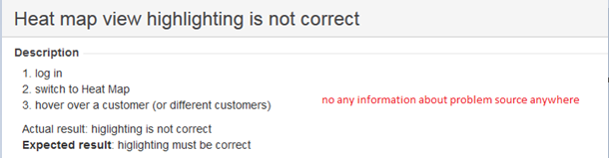
What is a bad bug report?
Bad bug report is a bug report that doesn’t clearly specify the problem

Slide 39
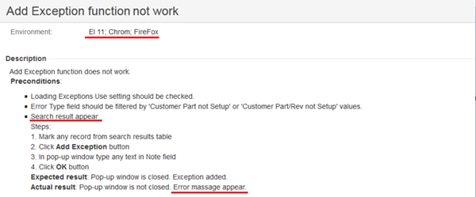
What is a bad bug report?
Bad bug report is a bug report that contains grammar or spelling mistakes, or written using not appropriate language

Slide 40
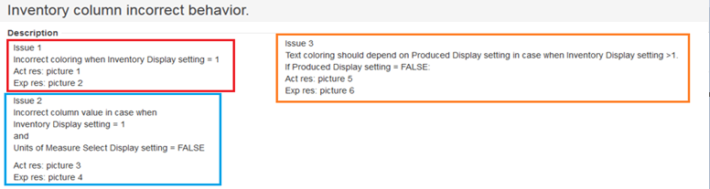
What is a bad bug report?
Bad bug report is a bug report that contains several issues
Exception! Many UI issues on 1 page - can be reported in one bug report

Slide 41
Thank You !

